Slide 1

Introduction to Probabilistic Machine Learning
Ralf Herbrich
Information Theory

Slide 2
Overview
Basics of Information Theory
Arithmetic Coding
Distance Measures for Probabilities

Slide 3
Overview
Basics of Information Theory
Arithmetic Coding
Distance Measures for Probabilities

Slide 4



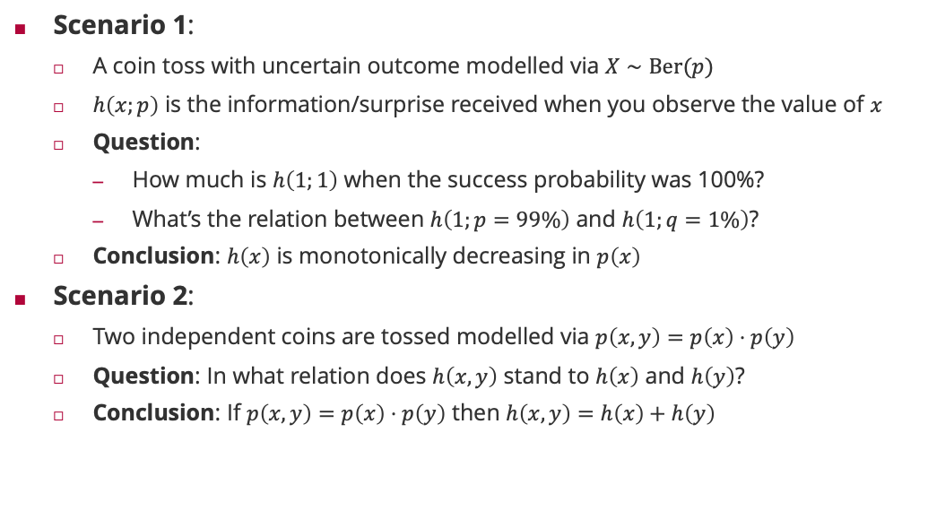






Motivating Example: Information and Coin Tosses
$$h\left(x,y\right) =h\left(x\right)+h\left(y\right)$$
$$h\left(x,y\right) >h\left(x\right)+h\left(y\right)$$
Scenario 1:
A coin toss with uncertain outcome modelled via $X∼Ber(p)$
$h\left(x;p\right)$ is the information/surprise received when you observe the value of $x$
Question:
How much is $h\left(1;1\right)$ when the success probability was 100%?
What’s the relation between $h\left(1;p=99\%\right)$ and $h\left(1;q=1\%\right)$?
Conclusion: $h\left(x\right)$ is monotonically decreasing in $p\left(x\right)$
Scenario 2:
Two independent coins are tossed modelled via $p\left(x,y\right)=p\left(x\right)⋅p\left(y\right)$
Question: In what relation does $h\left(x,y\right)$ stand to $h\left(x\right)$ and $h\left(y\right)$?
Conclusion: If $p\left(x,y\right)=p\left(x\right)⋅p\left(y\right)$ then $h\left(x,y\right)=h\left(x\right)+h\left(y\right)$
$$h\left(1;p\right)>h\left(1;q\right)$$
$$h(1;1) = 0$$
$$h\left(1;p\right)<h\left(1;q\right)$$
$$h\left(1;1\right)> 0$$
$$h\left(x,y\right) <h\left(x\right)+h\left(y\right)$$
$$h\left(1;p\right)=h\left(1;q\right)$$
$$h\left(x\right)=−\log_{b}\left(p\left(x\right)\right)⁡$$

Slide 5
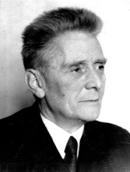
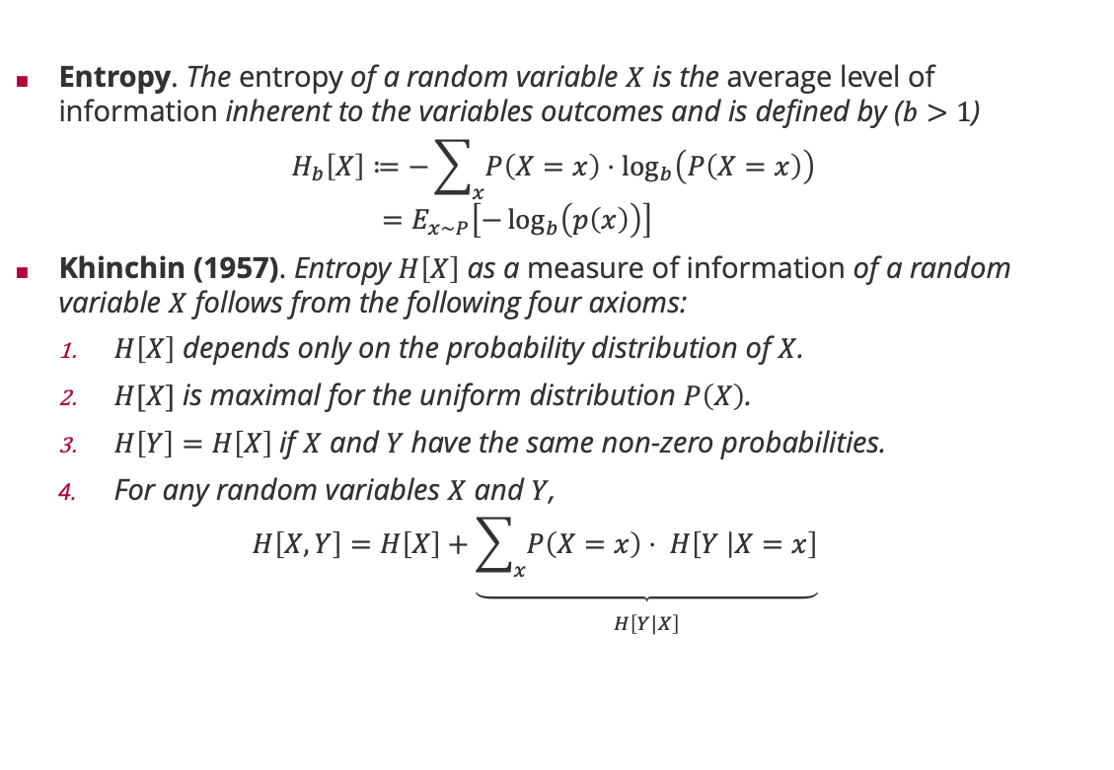
Measure of Information: Entropy
Entropy. The entropy of a random variable $X$ is the average level of information inherent to the variables outcomes and is defined by ($b>1$)
$$H_{b}\left[X\right]≔−\sum_{x}{P\left(X=x\right)⋅\log_{b}\left(P\left(X=x\right)\right) } \\ =E_{x∼P}\left[−\log_{b}\left(p\left(x\right)\right)\right]$$
Khinchin (1957). Entropy $H\left[X\right]$ as a measure of information of a random variable $X$ follows from the following four axioms:
$H\left[X\right]$ depends only on the probability distribution of $X$.
$H[X]$ is maximal for the uniform distribution $P\left(X\right)$.
$H\left[Y\right]=H\left[X\right]$if $X$ and $Y$have the same non-zero probabilities.
For any random variables $X$ and $Y$,
$$H\left[X, Y\right]=H\left[X\right]+\underset{\begin{aligned} \\ H\left[Y|X\right]\end{aligned}}{\underbrace{\sum_{x}{P\left(X=x\right)⋅ H\left[Y | X=x\right]}}}$$
Aleksandr Khinchin (1894 – 1959)

Slide 6

Example: Binary Entropy
$$H_{2}\left[p\right]=p⋅\log_{2}\left(p\right)+\left(1−p\right)⋅\log_{2}\left(1−p\right)$$

Slide 7

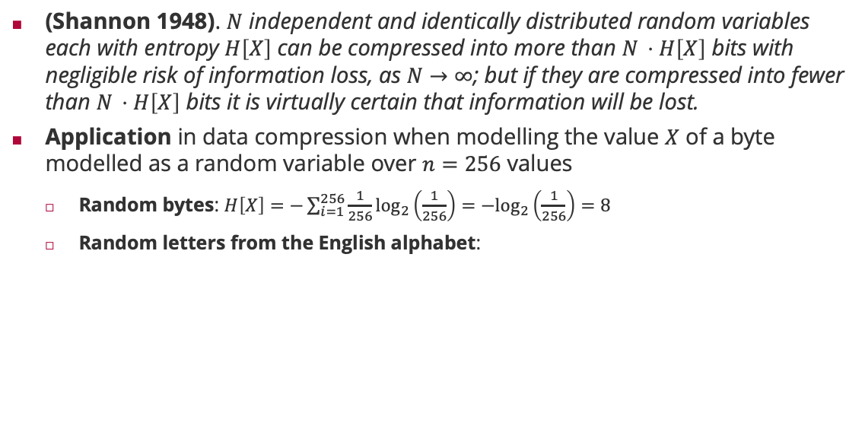

Entropy and the Noiseless Coding Theorem
(Shannon 1948). $N$ independent and identically distributed random variables each with entropy $H\left[X\right]$ can be compressed into more than $N ⋅H\left[X\right]$ bits with negligible risk of information loss, as $N→∞$; but if they are compressed into fewer than $N ⋅H\left[X\right]$ bits it is virtually certain that information will be lost.
Application in data compression when modelling the value $X$ of a byte modelled as a random variable over $n=256$ values
Random bytes: $H\left[X\right]=−\sum_{i=1}^{256}{\frac{1}{256}\log_{2}\left(\frac{1}{256}\right)=−\log_{2}\left(\frac{1}{256}\right)=8}$
Random letters from the English alphabet:
Claude Shannon (1913 – 2001)
$$H = 4.48917$$

Slide 8
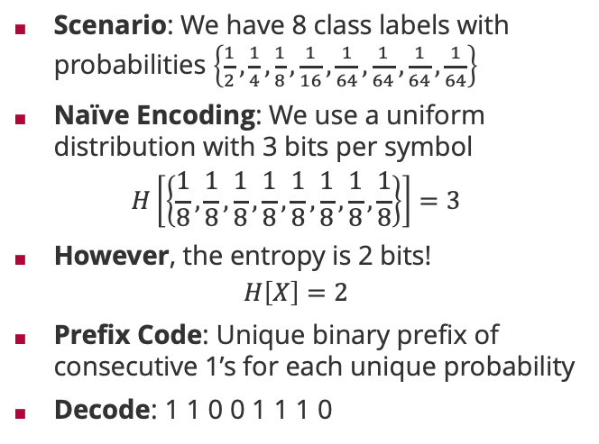

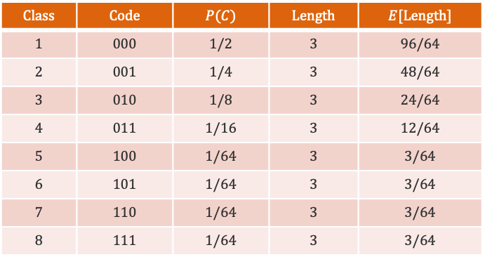


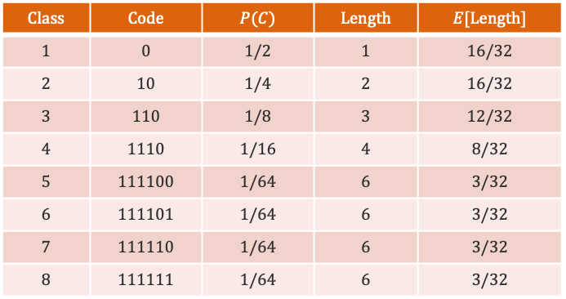
Noiseless Coding Theorem: An Example
Scenario: We have 8 class labels with probabilities $\left\{\frac{1}{2},\frac{1}{4},\frac{1}{8},\frac{1}{16},\frac{1}{64},\frac{1}{64},\frac{1}{64},\frac{1}{64}\right\}$
Naïve Encoding: We use a uniform distribution with 3 bits per symbol
$$H\left[\left\{\frac{1}{8},\frac{1}{8},\frac{1}{8},\frac{1}{8},\frac{1}{8},\frac{1}{8},\frac{1}{8},\frac{1}{8}\right\}\right]=3$$
However, the entropy is 2 bits!
$$H\left[X\right]=2$$
Prefix Code: Unique binary prefix of consecutive 1’s for each unique probability
Decode: 1 1 0 0 1 1 1 0
$$Class$$ | $$Code$$ | $$P(C)$$ | $$Length$$ | $$E[Length]$$
$$1$$ | $$0$$ | $$1/2$$ | $$1$$ | $$16/32$$
$$2$$ | $$10$$ | $$1/4$$ | $$2$$ | $$16/32$$
$$3$$ | $$110$$ | $$1/8$$ | $$3$$ | $$12/32$$
$$4$$ | $$1110$$ | $$1/16$$ | $$4$$ | $$8/32$$
$$5$$ | $$111100$$ | $$1/64$$ | $$6$$ | $$3/32$$
$$6$$ | $$111101$$ | $$1/64$$ | $$6$$ | $$3/32$$
$$7$$ | $$111110$$ | $$1/64$$ | $$6$$ | $$3/32$$
$$8$$ | $$111111$$ | $$1/64$$ | $$6$$ | $$3/32$$
$$Class$$ | $$Code$$ | $$P(C)$$ | $$Length$$ | $$E[Length]$$
$$1$$ | $$000$$ | $$1/2$$ | $$3$$ | $$96/64$$
$$2$$ | $$001$$ | $$1/4$$ | $$3$$ | $$48/64$$
$$3$$ | $$010$$ | $$1/8$$ | $$3$$ | $$24/64$$
$$4$$ | $$011$$ | $$1/16$$ | $$3$$ | $$12/64$$
$$5$$ | $$100$$ | $$1/64$$ | $$3$$ | $$3/64$$
$$6$$ | $$101$$ | $$1/64$$ | $$3$$ | $$3/64$$
$$7$$ | $$110$$ | $$1/64$$ | $$3$$ | $$3/64$$
$$8$$ | $$111$$ | $$1/64$$ | $$3$$ | $$3/64$$
$$C_{3}$$
$$C_{1}$$
$$C_{4}$$

Slide 9
Overview
Basics of Information Theory
Arithmetic Coding
Distance Measures for Probabilities

Slide 10



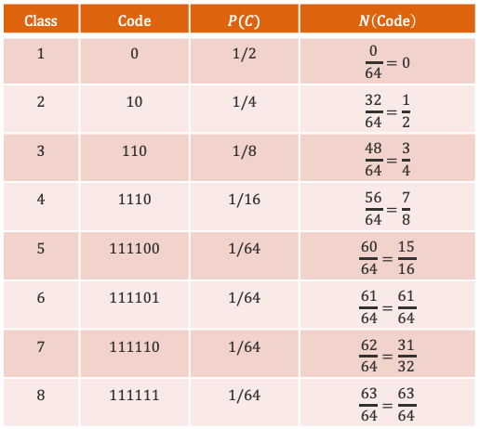


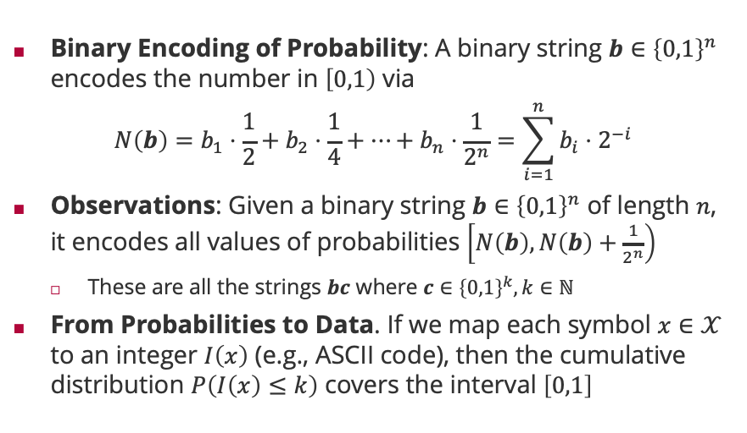







Arithmetic Coding
Binary Encoding of Probability: A binary string $b∈{\left\{0,1\right\}}^{n}$ encodes the number in $\left[0,1\right)$ via
$$N\left(b\right)=b_{1}⋅\frac{1}{2}+b_{2}⋅\frac{1}{4}+⋯+b_{n}⋅\frac{1}{2^{n}}=\sum_{i=1}^{n}{{b_{i}⋅2}^{−i}}$$
Observations: Given a binary string $b∈{\left\{0,1\right\}}^{n}$ of length $n$, it encodes all values of probabilities $\left[N\left(b\right),N\left(b\right)+\frac{1}{2^{n}}\right)$
These are all the strings $bc$ where $c∈{\left\{0,1\right\}}^{k}, k∈ℕ$
From Probabilities to Data. If we map each symbol $x∈𝒳$ to an integer $I\left(x\right)$ (e.g., ASCII code), then the cumulative distribution $P\left(I\left(x\right)≤k\right)$ covers the interval $\left[0,1\right]$
$$Class$$ | $$Code$$ | $$P(C)$$ | $$N\left(Code\right)$$
$$1$$ | $$0$$ | $$1/2$$ | $$\frac{0}{64}=0$$
$$2$$ | $$10$$ | $$1/4$$ | $$\frac{32}{64}=\frac{1}{2}$$
$$3$$ | $$110$$ | $$1/8$$ | $$\frac{48}{64}=\frac{3}{4}$$
$$4$$ | $$1110$$ | $$1/16$$ | $$\frac{56}{64}=\frac{7}{8}$$
$$5$$ | $$111100$$ | $$1/64$$ | $$\frac{60}{64}=\frac{15}{16}$$
$$6$$ | $$111101$$ | $$1/64$$ | $$\frac{61}{64}=\frac{61}{64}$$
$$7$$ | $$111110$$ | $$1/64$$ | $$\frac{62}{64}=\frac{31}{32}$$
$$8$$ | $$111111$$ | $$1/64$$ | $$\frac{63}{64}=\frac{63}{64}$$
$$C_{1}$$
$$C_{2}$$
$$C_{3}$$
$$C_{4}$$
$$C_{5}$$
$$C_{6}$$
$$C_{7}$$
$$C_{8}$$
$$1.000000$$
$$0.000000$$
$$0.110000$$
$$0.111000$$
$$0.111101$$
$$0.111111$$
$$0.100000$$
$$0.111100$$
$$0.111110$$

Slide 11

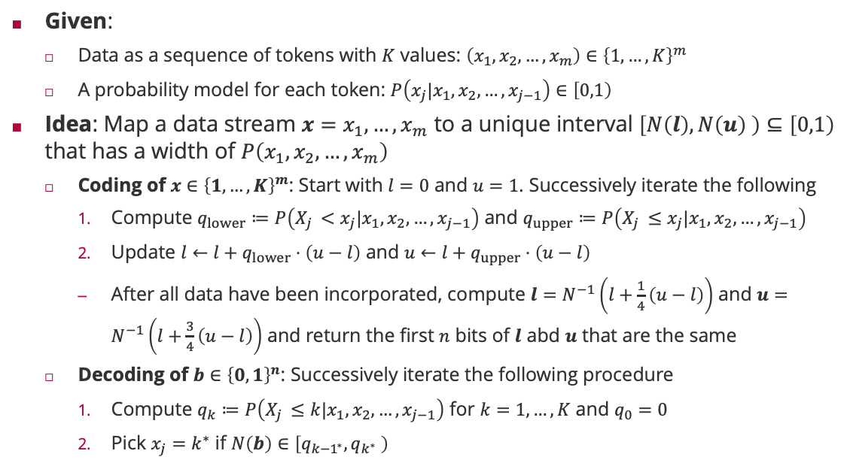
Arithmetic Coding: Algorithm
Given:
Data as a sequence of tokens with $K$ values: $\left(x_{1},x_{2},…,x_{m}\right)∈{\left\{1,…,K\right\}}^{m}$
A probability model for each token: $P\left(x_{j}|x_{1},x_{2},…,x_{j−1}\right)∈\left[0,1\right)$
Idea: Map a data stream $x=x_{1}, …,x_{m}$ to a unique interval $\left[N\left(l\right),N\left(u\right) \right)⊆\left[0,1\right)$ that has a width of $P\left(x_{1},x_{2},…,x_{m}\right)$
Coding of $x∈{\left\{1,…,K\right\}}^{m}$: Start with $l=0$ and $u=1$. Successively iterate the following
Compute $q_{lower}≔P\left(X_{j }<x_{j}|x_{1},x_{2},…,x_{j−1}\right)$ and $q_{upper}≔P\left(X_{j }≤x_{j}|x_{1},x_{2},…,x_{j−1}\right)$
Update $l←l+q_{lower}⋅\left(u−l\right)$ and $u←l+q_{upper}⋅\left(u−l\right)$
After all data have been incorporated, compute $l=N^{−1}\left(l+\frac{1}{4}\left(u−l\right)\right)$ and $u=N^{−1}\left(l+\frac{3}{4}\left(u−l\right)\right)$ and return the first $n$ bits of $l$ abd $u$ that are the same
Decoding of $b∈{\left\{0,1\right\}}^{n}$: Successively iterate the following procedure
Compute $q_{k}≔P\left(X_{j }≤k|x_{1},x_{2},…,x_{j−1}\right)$ for $k=1,…,K$ and $q_{0}=0$
Pick $x_{j}=k^{∗}$ if $N\left(b\right)∈\left[q_{{k−1}^{∗}},q_{k^{∗}} \right)$
Jorma Rissanen (1932 – 2020)

Slide 12



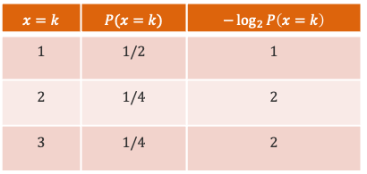







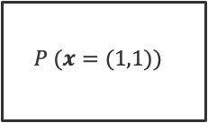







Arithmetic Coding: An Example
$$x=k$$ | $$P(x=k)$$ | $$−\log_{2}{P\left(x=k\right)}$$
$$1$$ | $$1/2$$ | $$1$$
$$2$$ | $$1/4$$ | $$2$$
$$3$$ | $$1/4$$ | $$2$$
$$0$$
$$0$$
$$x=\left(1,2\right)$$
$$P(x_{1}=1)$$
$$P (x=(1,1))$$
$$\frac{1}{4}$$
$$P (x=\left(1,2\right))$$
$$\frac{3}{8}$$
$$b=\left(0,1,0\right)$$
$$P (x=\left(1,3\right))$$
$$\frac{1}{2}$$
$$\frac{1}{2}$$
$$P(x_{1}=2)$$
$$l=\frac{1}{4}+\frac{1}{4}⋅\frac{1}{8}=\frac{9}{32}={0.01001}_{2}$$
$$\frac{3}{4}$$
$$u=\frac{1}{4}+\frac{3}{4}⋅\frac{1}{8}=\frac{11}{32}={0.01011}_{2}$$
$$P(x_{1}=3)$$
$$1$$

Slide 13

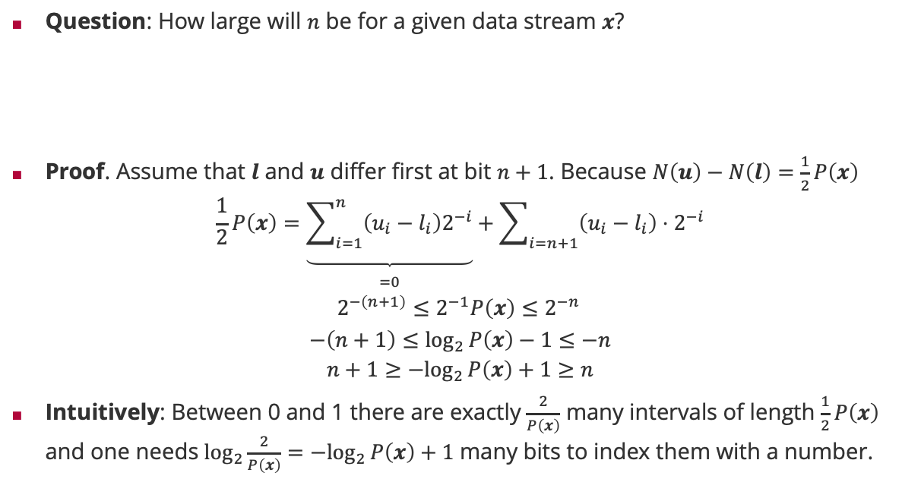
Arithmetic Coding: Optimal Code Length
Question: How large will $n$ be for a given data stream $x$?
Proof. Assume that $l$ and $u$ differ first at bit $n+1$. Because $N\left(u\right)−N\left(l\right)=\frac{1}{2}P\left(x\right)$
$$\frac{1}{2}P\left(x\right)=\underset{\begin{aligned} \\ =0\end{aligned}}{\underbrace{\sum_{i=1}^{n}{\left(u_{i}−l_{i}\right)2^{−i}}}}+\sum_{i=n+1}{\left(u_{i}−l_{i}\right)⋅2^{−i}}$$
$$2^{−\left(n+1\right)}≤2^{−1}P\left(x\right)≤2^{−n }$$
$$−\left(n+1\right)≤\log_{2}{P\left(x\right)−1}≤−n$$
$$n+1≥{−log}_{2}{P\left(x\right)}+1≥n$$
Intuitively: Between 0 and 1 there are exactly $\frac{2}{P\left(x\right)}$ many intervals of length $\frac{1}{2}P\left(x\right)$ and one needs $\log_{2}\frac{2}{P\left(x\right)}={−log}_{2}{P\left(x\right)}+1$ many bits to index them with a number.
$$−\log_{2}{P\left(x\right)}≤n≤−\log_{2}{P\left(x\right)}+1$$

Slide 14
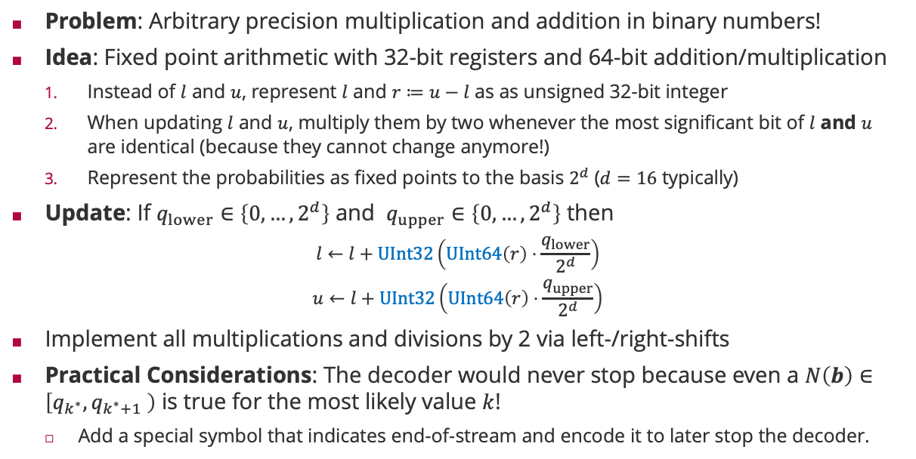
Arithmetic Coding: Fixed Point Arithmetic
Problem: Arbitrary precision multiplication and addition in binary numbers!
Idea: Fixed point arithmetic with 32-bit registers and 64-bit addition/multiplication
Instead of $l$ and $u$, represent $l$ and $r≔u−l$ as as unsigned 32-bit integer
When updating $l$ and $u$, multiply them by two whenever the most significant bit of $l$ and $u$ are identical (because they cannot change anymore!)
Represent the probabilities as fixed points to the basis $2^{d}$ ($d=16$ typically)
Update: If $q_{lower}∈\left\{0,…,2^{d}\right\}$ and $q_{upper}∈\left\{0,…,2^{d}\right\}$ then
$$l←l+UInt32\left(UInt64\left(r\right)⋅\frac{q_{lower}}{2^{d}}\right)$$
$$u←l+UInt32\left(UInt64\left(r\right)⋅\frac{q_{upper}}{2^{d}}\right)$$
Implement all multiplications and divisions by 2 via left-/right-shifts
Practical Considerations: The decoder would never stop because even a $N\left(b\right)∈\left[q_{k^{∗}},q_{k^{∗}+1} \right)$ is true for the most likely value $k$!
Add a special symbol that indicates end-of-stream and encode it to later stop the decoder.

Slide 15
Overview
Basics of Information Theory
Arithmetic Coding
Distance Measures for Probabilities

Slide 16
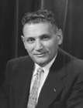
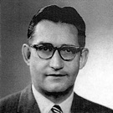
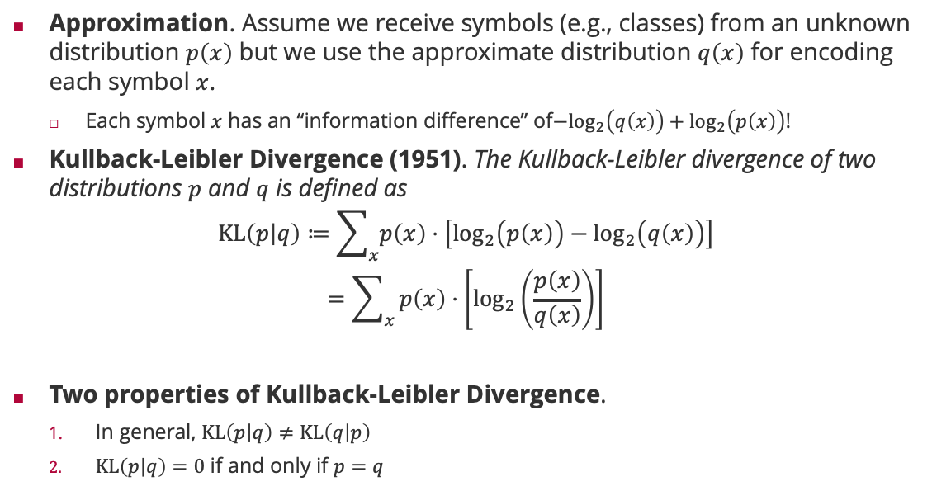
Relative Entropy: Kullback-Leibler Divergence
Approximation. Assume we receive symbols (e.g., classes) from an unknown distribution $p\left(x\right)$ but we use the approximate distribution $q\left(x\right)$ for encoding each symbol $x$.
Each symbol $x$ has an “information difference” of${−log}_{2}\left(q\left(x\right)\right)+\log_{2}\left(p\left(x\right)\right)$!
Kullback-Leibler Divergence (1951). The Kullback-Leibler divergence of two distributions $p$ and $q$ is defined as
$$KL\left(p | q\right)≔\sum_{x}{p\left(x\right)⋅\left[\log_{2}\left(p\left(x\right)\right)−\log_{2}\left(q\left(x\right)\right)\right]}$$
$$=\sum_{x}{p\left(x\right)⋅\left[\log_{2}\left(\frac{p\left(x\right)}{q\left(x\right)}\right)\right]}$$
Two properties of Kullback-Leibler Divergence.
In general, $KL\left(p | q\right)≠KL\left(q | p\right)$
$KL\left(p | q\right)=0$ if and only if $p=q$
Solomon Kullback (1909 – 1994)
Richard Leibler (1914 – 2003)

Slide 17



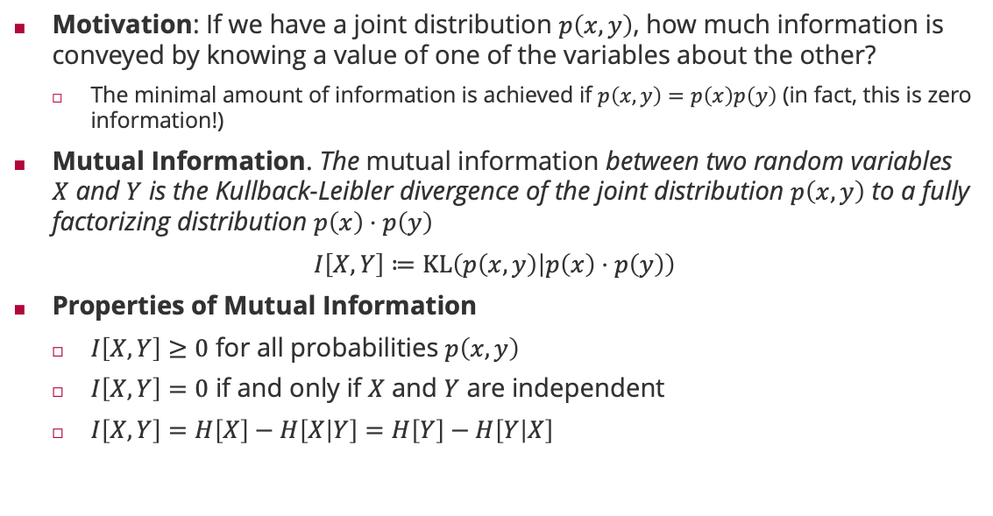



Mutual Information
Motivation: If we have a joint distribution $p\left(x,y\right)$, how much information is conveyed by knowing a value of one of the variables about the other?
The minimal amount of information is achieved if $p\left(x,y\right)=p\left(x\right)p\left(y\right)$ (in fact, this is zero information!)
Mutual Information. The mutual information between two random variables $X$ and $Y$ is the Kullback-Leibler divergence of the joint distribution $p\left(x,y\right)$ to a fully factorizing distribution $p\left(x\right)⋅p\left(y\right)$
$I\left[X,Y\right]≔KL\left(p\left(x,y\right) | p\left(x\right)⋅p\left(y\right)\right)$
Properties of Mutual Information
$I\left[X,Y\right]≥0$ for all probabilities $p\left(x,y\right)$
$I\left[X,Y\right]=0$ if and only if $X$ and $Y$ are independent
$I\left[X,Y\right]=H\left[X\right]−H\left[X | Y\right]=H\left[Y\right]−H\left[Y | X\right]$
$$H[X,Y]$$
$$H[X]$$
$$H[Y]$$
$$H[X|Y]$$
$I[X,Y]$
$$H[Y|X]$$

Slide 18
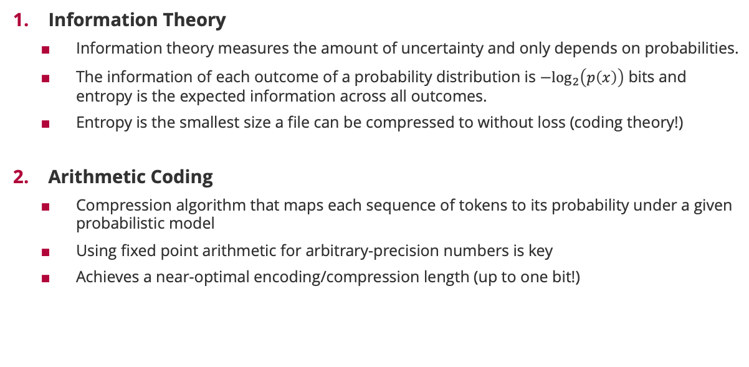
Summary
Information Theory
Information theory measures the amount of uncertainty and only depends on probabilities.
The information of each outcome of a probability distribution is $−\log_{2}\left(p\left(x\right)\right)$ bits and entropy is the expected information across all outcomes.
Entropy is the smallest size a file can be compressed to without loss (coding theory!)
Arithmetic Coding
Compression algorithm that maps each sequence of tokens to its probability under a given probabilistic model
Using fixed point arithmetic for arbitrary-precision numbers is key
Achieves a near-optimal encoding/compression length (up to one bit!)

Slide 19
See you next week!

